Slide 1
SIAS Fund Performance Review
Q2 2010
August 13, 2010
Genica Gao | Compliance & Performance Team | xingaox@sfu.ca | 778.859.9619
Ted Hsieh | Risk Metrics Team | sth4@sfu.ca | 604.518.1622
Jerry Su | Economics and Portfolio Strategy Team | jerrys@sfu.ca | 778.989.3679
Jerry Chen | Canadian & Global Equity Team | jerryc@sfu.ca | 604.506.7648
Belinda Liao | Fixed Income Team | bliao@sfu.ca | 604.767.2633

Slide 2
Agenda
1. Compliance and Performance
2. Risk Metrics
3. Economics and Strategy
4. Canadian Equity
5. Global Equity
6. Fixed Income
7. Transition to Next Cohort
8. Conclusion and Q&A

Slide 3
IPS Guidelines and Constraints |  | Compliance | Comments
1. | Asset Mix within IPS Range | Yes
2. | Equities
 | a) Min. 25 holdings (max < 35) | Yes | 33 holdings for Canada vs 34 last Q
 |  |  | 27 holdings for Global (10 ETFs) vs 29 last Q
 | b) Each holding < 10% of equity portfolio | Yes
 | c) Largest 15 holdings < 70% of equity portfolio | Yes
 | d) Min. 7 industry sectors of GICS | Yes | All 10 Industry Sectors of GICS
 | e) Small Cap < 5% | Yes | None
 | f) Venture Cap total < 5% | Yes | None
3. | Fixed Income |  | 19 holdings (only Canadian issues)
 | a) Credit rating: < 10% BBB, and 0% below BBB | Yes | 1 holding = BBB (< 10%)
 | b) Non-Government issue < 5% of portfolio | Yes
4. | Loans and Borrowing
 | a) No margin or short selling | Yes
 | b) No derivatives trading | Yes
Notes | Out of Compliance Record | No

Slide 4
SIAS Portfolio Q2 2010 Performance
Portfolio excess return:
Difference=Actual-benchmark
66 bp
Actual return on portfolio:
weight(p)*return(p)
-392 bp
Actual return on benchmark:
weight(b)*return(b)
-458 bp

Slide 5
Attribution Analysis
Portfolio excess return:
66 bp

Slide 6

Canadian Equity Attribution by Selected Sectors (%)
Total Excess Return:
-111 bp (all sectors)
Asset Allocation | 0.03 | 0.12 | - 0.05 | 0.00 | 0.12
Selection Decision | - 0.23 | 0.02 | 0.10 | - 1.43 | 0.12
Interaction | 0.01 | 0.10 | 0.01 | - 0.11 | - 0.12
Value Added | - 0.19 | 0.24 | 0.06 | - 1.54 | 0.12

Slide 7

Global Equity Attribution (%)
Total Excess Return:
185 bp
Currency | - 0.001 | 0.000 | 0.003 | - 0.002 | 0.001
Mkt Allocation | 0.29 | - 0.03 | - 0.83 | 0.83 | 0.29
Selection | 0.11 | - 0.16 | 0.83 | 0.94 | 1.72
Interaction | - 0.04 | -0.02 | 0.38 | - 0.48 | - 0.16
Value Added | 0.36 | - 0.21 | 0.38 | 1.31 | 1.85

Slide 8
Fixed Income Attribution
Total Excess Return:
-4 bp
Federal | 0.00 | 0.25 | -0.46 | 0.39 | 0.13 | - 0.0020
Provincial | 0.00 | 0.45 | -0.46 | 0.02 | 0.02 | 0.0015
Municipal | 0.00 | 1.26 | -1.41 | 0.12 | -0.15 | 0.0001
Corporate | 0.00 | 0.21 | -0.30 | 0.08 | -0.03 | 0.0000
Total | 0.0003 | 0.2763 | -0.2710 | 0.0074 | -0.0134 | -0.0004

Slide 9
Top performers vs. losers
Top 5 Market Gainers
Name |  | Dollar Amount | %
BARRICK GOLD CORP | $ | 33,660.00 | 23.99
BIOVAIL CORP | $ | 24,640.00 | 20.72
TELUS CORP | $ | 4,384.50 | 6.27
MOLSON COORS CDA INC | $ | 4,090.60 | 6.08
REITMANS (CANADA) LTD | $ | 3,528.00 | 4.69
Top 5 Market Losers
Name |  | Dollar Amount | %
CANADIAN NATURAL RESOURCES | $ | 9,696.50 | 53.00
FIRST QUANTUM MINERALS LTD | $ | 45,030.00 | 35.92
RESEARCH IN MOTION LTD | $ | 38,964.00 | 30.46
TECK RESOURCES LTD | $ | 57,465.00 | 28.86
INMET MINING CORP | $ | 29,505.00 | 28.57

Slide 10
Risk Metrics & Attribution
Ted Hsieh
sth4@sfu.ca

Slide 13
Daily portfolio losses exceed 2.5% and 3.1% on May 20 & June 29
Daily portfolio volatility rapidly increases by 35 b.p. (15.4% ) and 43 b.p. (18.4%)
Financial, Energy, and Material sectors attribute to over 75% and 83% of the losses

Slide 14
Quarterly Average VaR is 2.8% and the 6 individual stocks make up over 50% of portfolio risk

Slide 15
 | Financials | Health Care | Utilities | Cons. Disc. | Cons. Stap. | Energy | Info. Tech. | Materials | Tele. Svs. | Indus. | Total
Allocation | -0.0066% | 0.0119% | 0.0047% | 0.0035% | 0.0152% | 0.0339% | 0.0015% | 0.0185% | 0.0027% | -0.0509% | 0.0345%
Selection | 0.0444% | 0.0005% | -0.0027% | -0.0114% | -0.0011% | -0.0103% | 0.0068% | 0.0940% | 0.0023% | -0.0509% | 0.0717%
Interaction | -0.0012% | 0.0033% | -0.0016% | -0.0015% | -0.0017% | -0.0012% | 0.0004% | 0.0075% | 0.0004% | 0.0509% | 0.0552%
Risk Added | 0.0366% | 0.0157% | 0.0005% | -0.0095% | 0.0124% | 0.0224% | 0.0088% | 0.1200% | 0.0053% | -0.0509% | 0.1614%
Relatively riskier than S&P/TSX index by 16 b.p.

Slide 16
Canadian Equity Q2 Return Attribution
 | Financials | Health Care | Utilities | Cons. Disc. | Cons. Stap. | Energy | Info. Tech. | Materials | Tele. Svs. | Indus. | Total
Allocation | 0.0300% | 0.1180% | -0.0177% | 0.0033% | -0.1289% | -0.0528% | -0.0186% | 0.0044% | 0.0096% | 0.1231% | 0.0704%
Selection | -0.2262% | 0.0169% | 0.0395% | 0.0454% | 0.1059% | 0.1037% | -0.0645% | -1.4272% | 0.0182% | 0.1231% | -1.2651%
Interaction | 0.0063% | 0.1050% | 0.0228% | 0.0061% | 0.1667% | 0.0122% | -0.0041% | -0.1139% | 0.0030% | -0.1231% | 0.0810%
Value Added | -0.1898% | 0.2399% | 0.0447% | 0.0548% | 0.1436% | 0.0631% | -0.0873% | -1.5366% | 0.0308% | 0.1231% | -1.1137%
Canadian Equity Q2 Risk Attribution
 | Financials | Health Care | Utilities | Cons. Disc. | Cons. Stap. | Energy | Info. Tech. | Materials | Tele. Svs. | Indus. | Total
Allocation | -0.0066% | 0.0119% | 0.0047% | 0.0035% | 0.0152% | 0.0339% | 0.0015% | 0.0185% | 0.0027% | -0.0509% | 0.0345%
Selection | 0.0444% | 0.0005% | -0.0027% | -0.0114% | -0.0011% | -0.0103% | 0.0068% | 0.0940% | 0.0023% | -0.0509% | 0.0717%
Interaction | -0.0012% | 0.0033% | -0.0016% | -0.0015% | -0.0017% | -0.0012% | 0.0004% | 0.0075% | 0.0004% | 0.0509% | 0.0552%
Risk Added | 0.0366% | 0.0157% | 0.0005% | -0.0095% | 0.0124% | 0.0224% | 0.0088% | 0.1200% | 0.0053% | -0.0509% | 0.1614%
Canadian Equity Q2 Risk Adjusted Attribution
Risk Adjusted Value Added | -0.2264% | 0.2242% | 0.0442% | 0.0642% | 0.1312% | 0.0407% | -0.0960% | -1.6567% | 0.0254% | 0.1740% | -1.2751%

Slide 17
Allocation | -0.0175% | 0.0059% | -0.0812% | 0.1244% | 0.0315%
Selection | 0.0760% | 0.0225% | 0.1719% | 0.0462% | 0.3166%
Interaction | -0.0291% | 0.0014% | -0.0882% | 0.0215% | -0.0945%
Risk Added | 0.0294% | 0.0298% | 0.0024% | 0.1920% | 0.2537%
Relatively riskier than MSCI index by 25 b.p.

Slide 18
Value Added | 1.0308% | -0.5975% | 3.7667% | 1.0905% | 5.2905%
Allocation | -0.0175% | 0.0059% | -0.0812% | 0.1244% | 0.0315%
Selection | 0.0760% | 0.0225% | 0.1719% | 0.0462% | 0.3166%
Interaction | -0.0291% | 0.0014% | -0.0882% | 0.0215% | -0.0945%
Risk Added | 0.0294% | 0.0298% | 0.0024% | 0.1920% | 0.2537%
Risk Adjusted Value Added | 1.0014% | -0.6273% | 3.7642% | 0.8985% | 5.0368%

Slide 19
Sharpe (VaR) Ratio
Canadian Equity in Q2
Global Equity in Q2
Return (%)
Portfolio: 3.095
Return (%)
MSCI: 5.643
TSX:2.386
Portfolio: 1.589
0.688 (Rf)
0.813 (Rf)
VaR (%)
VaR (%)
Equity
VaR:2.48%
Canadian Equity
VaR: 2.8%
Global Equity
VaR: 2.2%
Canadian Equity is 44% Diversified
Global Equity is 32% Diversified
Correlation between the two is 0.98+,
so the diversification is less than 1%

Slide 20
Economics & Portfolio Strategy
Jerry Su
Jerry_su@sfu.ca

Slide 21
Recovery or Double Dip?
Euro-Zone
World’s 2nd largest Economy
Notes:
Don’t say I am here to show you. Show more conviction. Thank you Ted. The three big concerns for our fund this quarter are recovery vs double dip, further coverage on the euro zone and looking at the world’s economy.

Slide 22


Slower than expected recovery
Notes:
Canada and US had not shown robust recovery as we had hoped for. This is especially evident in the us.

Slide 23
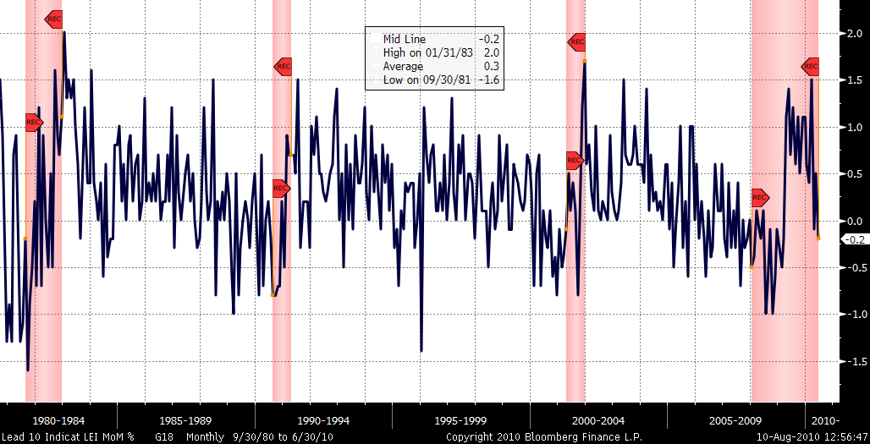
LEI for United States
Notes:
Looking at the economic indicators in the US, we have not seen a linear recovery. Large volatility in the economic indicators has lead to large volatility in the stock markets

Slide 24
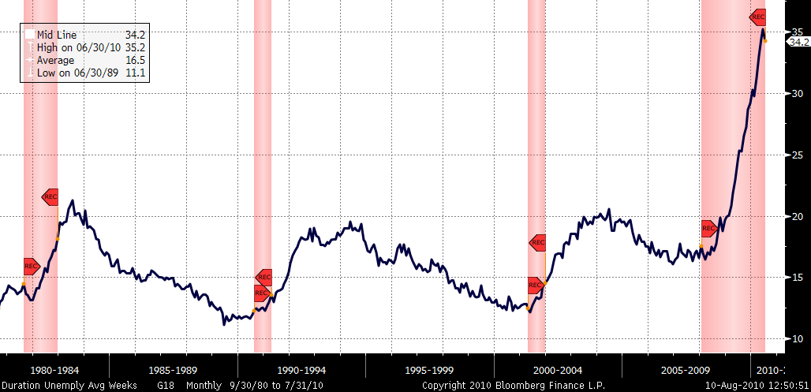
Duration of Unemployment
Notes:
More convicition. The duration of unemployment continues to rise. This is a concern because the longer somebody is unemployed, the more discourage they become and they stop looking for jobs. Therefore leading a decrease of production and wage outlook

Slide 25
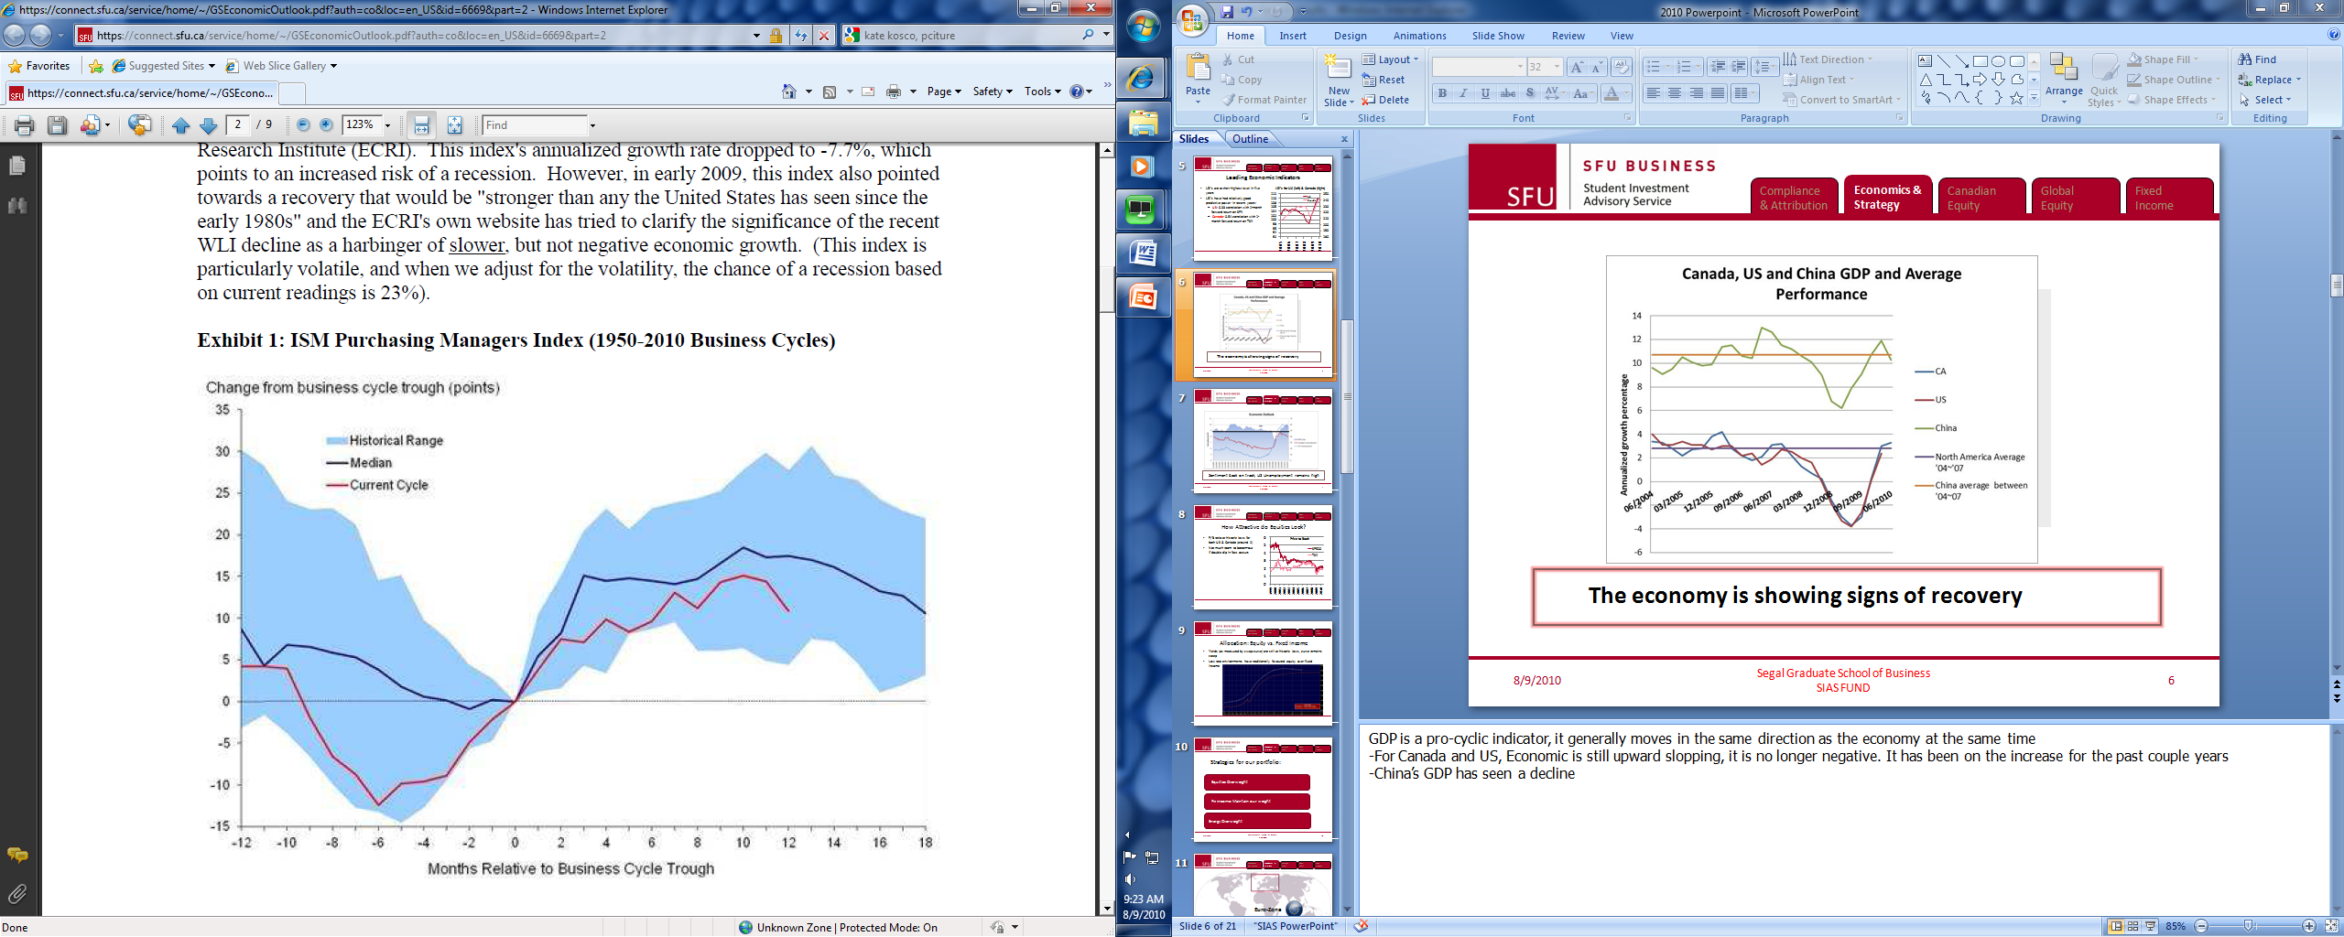
Inflection Point
Sentiment back on track, US Unemployment remains high
Notes:
On a slight positive note, the purchasing manager index has been positive for the past 9 month. And is above the lower end of the historical range.

Slide 26
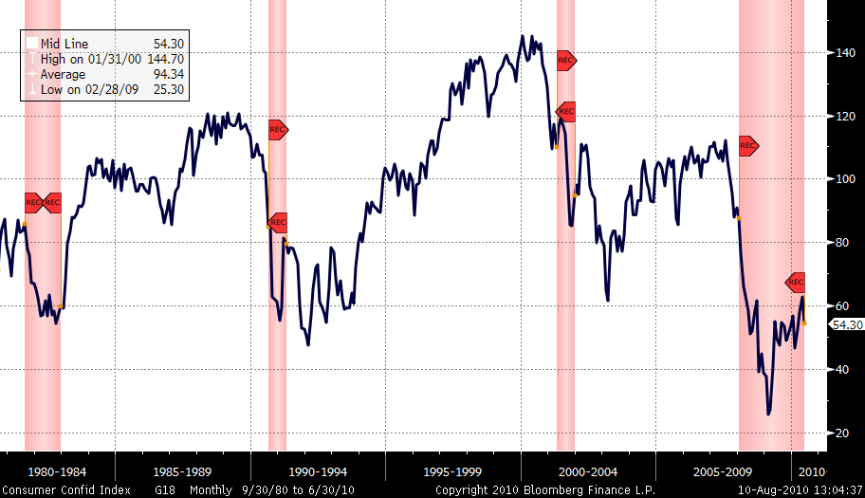
Consumer Confidence
Notes:
US is a consumer driven economy. We do not believe it will continue to be the driving force of ROW because consumers are still recovering from the all time low in 2009. However…..

Slide 27
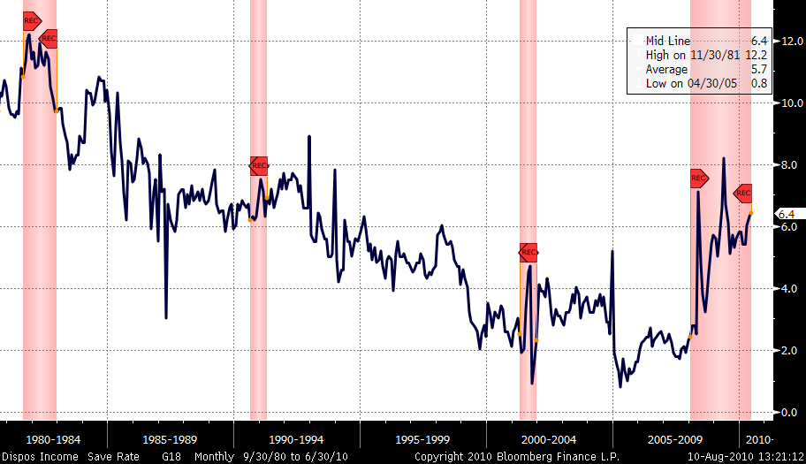
Savings Rate
Notes:
Savings rate has increased to levels above early 90’s. This shows that Americans are attempting to deleverage. In the long run, this is a good news because savings now will translate to investments later.

Slide 28
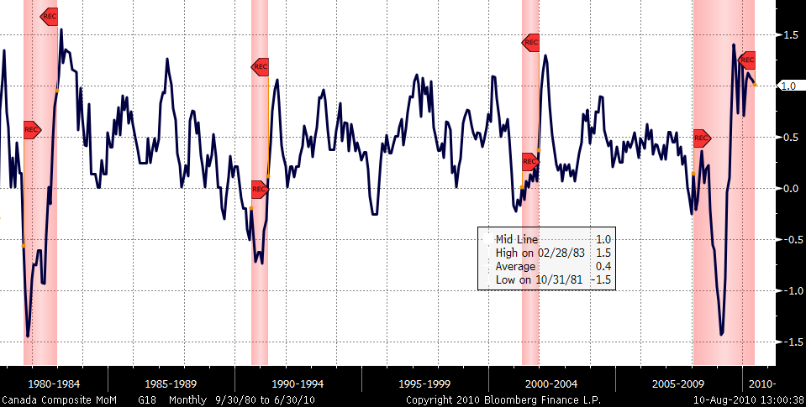
LEI for Canada
Notes:
Turning our attention to Canada, the LEI has been on the positive territory since beginning of 2009 and it is continue to stay there.

Slide 29
How Attractive do Equities Look?
P/B ratio at historic lows for both US & Canada (around 2)
Not much room to bottom-out if double dip in fact occurs
Notes:
Better transition to this slide. So where does this leave us with valuation. PB are very attractive in terms of US and CanadaWhat does all these translate to our equity investments. We don’t believe there is a bubble. Yes things are volatile, recovery isn’t as robust as people have hoped but , P/B shows that equities aren’t overpriced.

Slide 30
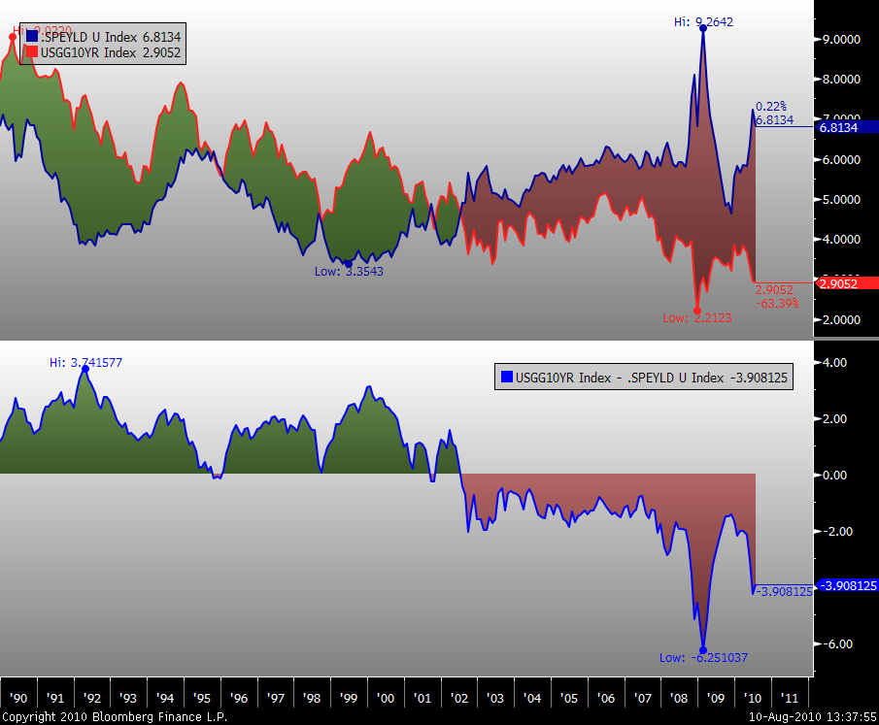
Spread between S&P500 Earnings Yield & 10 Year Government Bond Yield
1990 - 1994
1995-1999
2000-2004
2005-2009
2010
Notes:
When looking at valuation, we have to keep in the context of bond yields. In this chart, we have earning yield spread between 10 government bond and S&P 500. Relative to the bond market, we see equities as very attractive.

Slide 31

Euro-Zone
Notes:
Briefly looking over to Europe , we had been very underweight in this region of the world. However, as mentioned less quarter we believe that maybe it was time to be less cautions. Investor sentiments were the one big reason pusshing european stocks

Slide 32
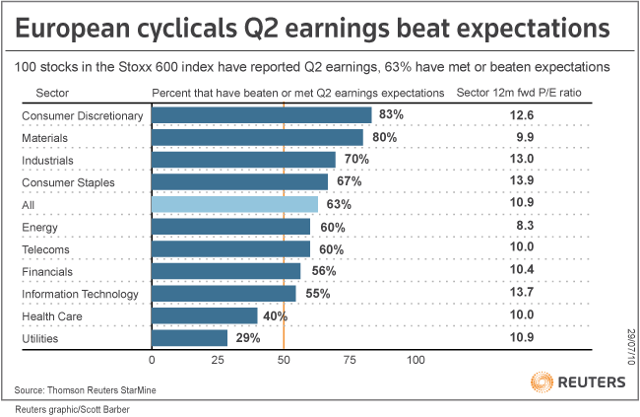
Notes:
STOXX® Europe 600
The STOXX Europe 600 Index is derived from the STOXX Europe Total Market Index (TMI) and is a subset of the STOXX Global 1800 Index. With a fixed number of 600 components, the STOXX Europe 600 Index represents large, mid and small capitalisation companies across 18 countries of the European region: Austria, Belgium, Denmark, Finland, France, Germany, Greece, Iceland, Ireland, Italy, Luxembourg, the Netherlands, Norway, Portugal, Spain, Sweden, Switzerland and the United Kingdom.

Slide 33
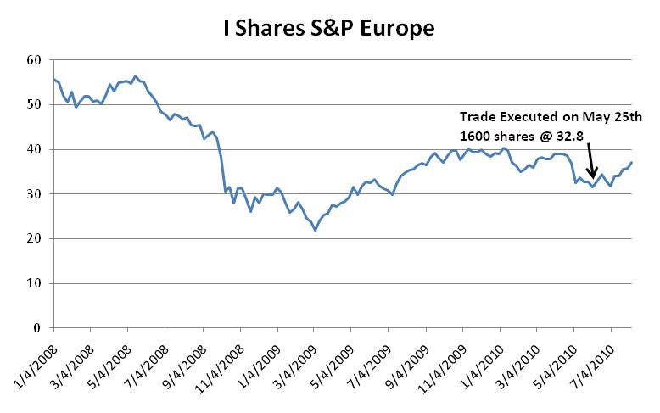

Slide 34

China & ROW
Notes:
We are looking at the slower economic growth in America than we are thinking. Europe are kind of bottoming out. Since US slower growht, that makes China all the more important.

Slide 35
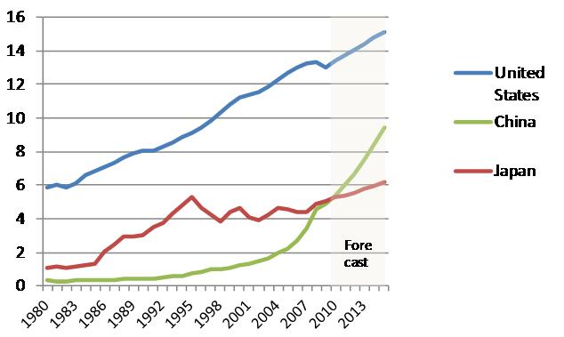
GDP of World’s Three Largest Economies
Trillion USD

Slide 36
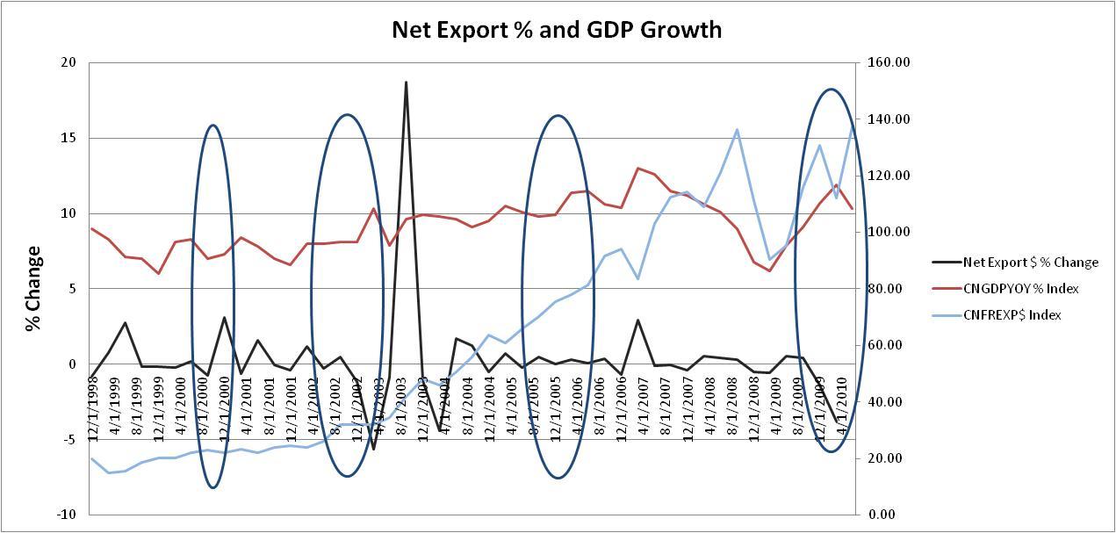

Slide 37
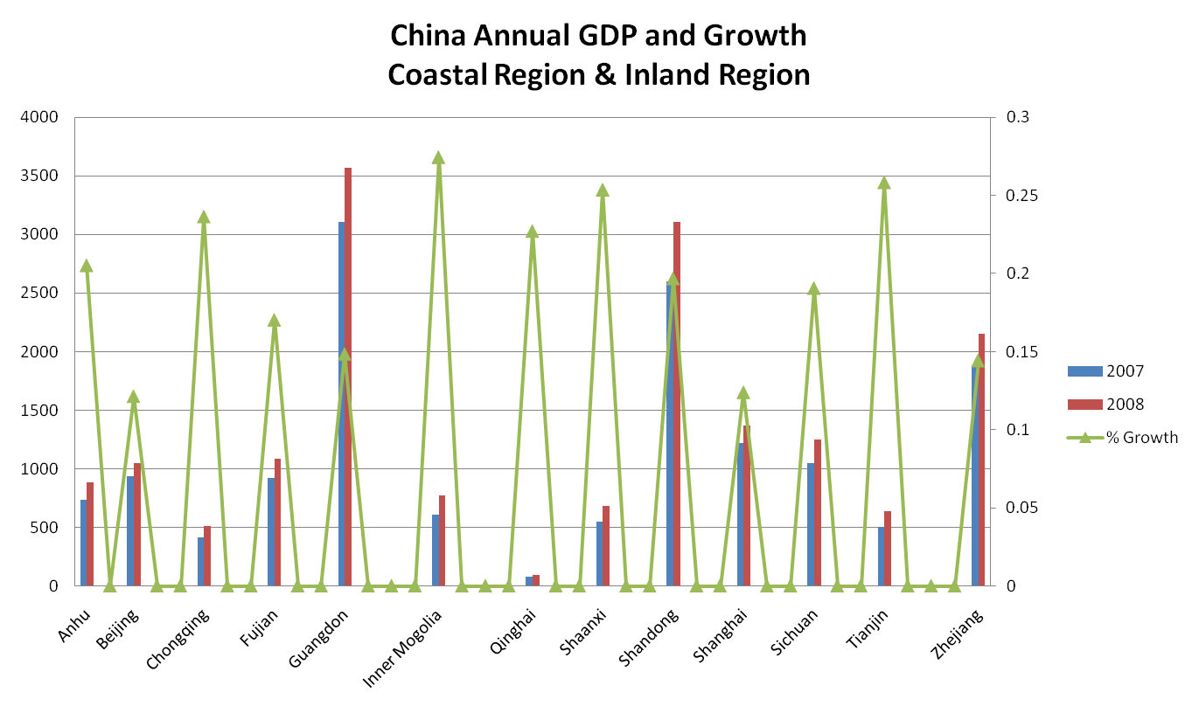
Notes:
These are the coastal regions and

Slide 38
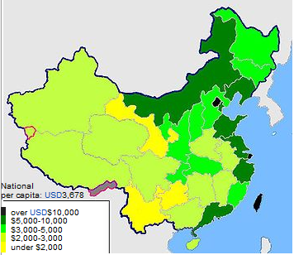
Most of China is still a Less Developed Country
Inner Mongolia
Beijing
Tianjin
Shandong
Jiangsu
Shanghai
Zhejiang
Guangdong

Slide 39

Risks Associated with our China Bet
Notes:
To cope with a more energy friendly environment, China is trying to stop the local regions from producing.
China starts a green attack
http://www.theglobeandmail.com/report-on-business/industry-news/energy-and-resources/energy-push-shuts-chinese-factories/article1666916/
Potential bubble
http://www.nytimes.com/2010/03/05/business/global/05yuan.html
http://www.washingtonpost.com/wp-dyn/content/article/2010/01/10/AR2010011002767.html
chinese government are limiting home buyers on 2nd loans as well as adding transaction tax to realestate
Rising labour wages, there aren’t unlimited supply of cheap labour.
http://www.businessweek.com/magazine/content/06_13/b3977049.htm

Slide 40
End of Q2
2010 Target
IPS Range
2%
1-3%
Cash
0-10%
Cash
26%
22-26%
Fixed Income
20-40%
Fixed Income
13%
Other
34-36%
Global Equity
30-40%
Global Equity
22%
US
37%
36-38%
Canadian Equity
30-40%
Canadian Equity

Slide 41
Canadian Equity
Jerry Chen
jerryc@sfu.ca

Slide 42
Canadian Equity Strategy
  37.69% of SIAS portfolio
  S&P/TSX was down about 6%
  SIAS Canadian Equity 110 b.p. worse
  Materials, Materials, Materials: -150 b.p. alpha

Slide 43
Problem stocks, sub-sector allocation
Materials sector outperformed TSX in Q2; our holdings did not
Mining: First Quantum, Teck, Inmet (-94 b.p.)
Gold: Gold stocks outperformed, but we didn’t have (-43 b.p.)
Gold and Copper Spot Price, Indexed to 100 at 3/31/2010
Market Weights
20.0%
19.9%
SIAS Bench

Slide 44
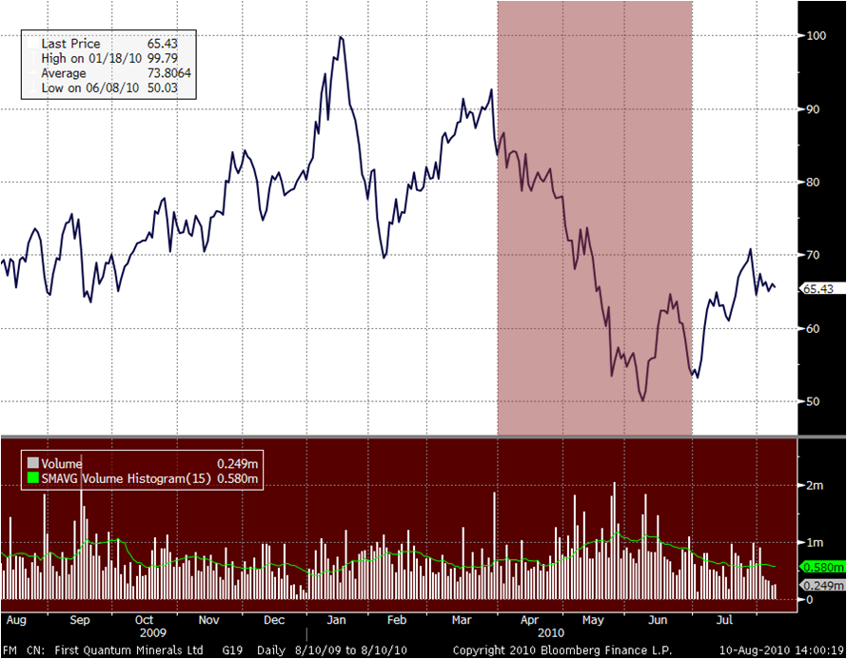
First Quantum (TSE:FM)
Q2 Performance: - 35.9% Post Q2: + 14%

Slide 45
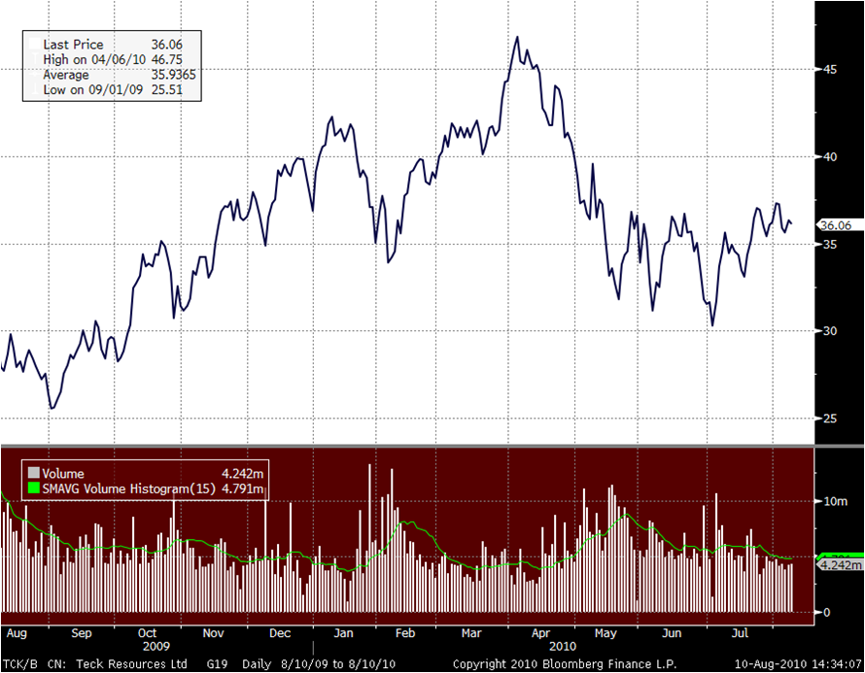
Teck Resources (TSE:TCK/B)
Q2 Performance: - 28.9% Post Q2: + 8.84%

Slide 46
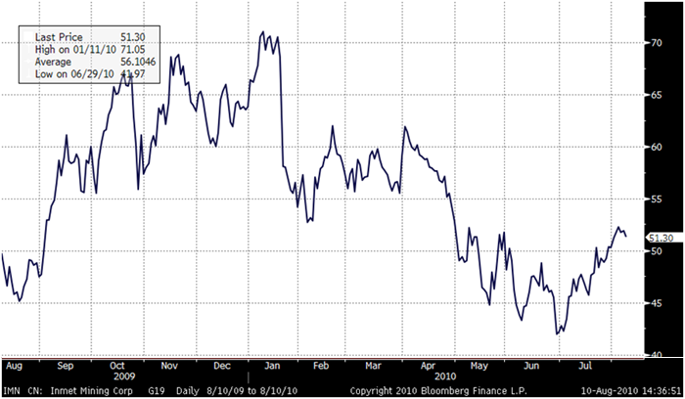
Inmet Mining (TSE:IMN)
Q2 Performance: - 28.6% Post Q2: + 18.94%

Slide 47
Materials Holdings
Company | Weights | % Change | Q2 Price | Current Price
BARRICK GOLD CORP | 5.23% | 24.0% | 48.32 | 44.31
POTASH | 4.47% | -24.4% | 91.69 | 112.90
AGRIUM INC | 1.59% | -27.6% | 52.00 | 67.21
INMET MINING CORP | 2.25% | -28.6% | 42.15 | 49.76
TECK RESOURCES LTD | 4.38% | -28.9% | 31.48 | 34.66
FIRST QUANTUM | 2.51% | -35.9% | 53.55 | 61.79

Slide 48
Materials Strategy
Monitor allocations WITHIN the sector more carefully
Continue to underweight gold, but less extreme?

Slide 49
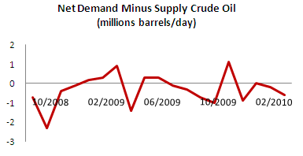
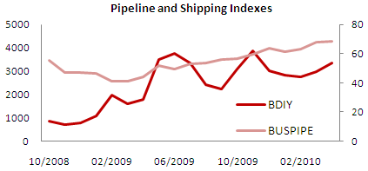
Energy Strategy
Market Weights
Short-term demand is in question, bullish on long-term
Overall economy, inventory level, shipping/pipeline show support
Tighter offshore drilling rules make oil sands more appealing
27.4%
26.3%
SIAS Bench

Slide 50
Major Financials Holdings
Financials down 19 b.p.
Company | Weights | % Change | Q2 Price | Current Price
TD BANK | 6.26% | -6.72% | 68.98 | 71.72
RBC | 8.13% | -14.7% | 50.70 | 52.06
BANK OF SCOTIA | 4.78% | -3.60% | 49.05 | 49.81
MANULIFE | 2.88% | -22.9% | 15.45 | 13.41
GREAT WEST LIFE | 2.19% | -5.09% | 24.07 | 24.93

Slide 51
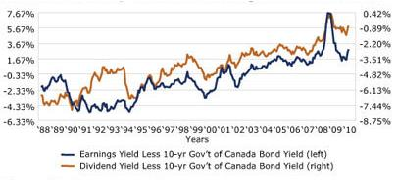
Stocks Are Cheap Based on Earnings, Dividend Yields

Slide 52
Stock Selection
Recent performance and VaR analysis suggested we may be under-diversified
Stock picking vs. sub-sector allocation
Fundamental Analysis + Commodity Research + Sector Strategy
Number of Stocks in CAD Equity
34 Stocks
33 Stocks
Food & Beverage (1)

Slide 53
Q2 Transaction Summary
Sold
Company | Value | Trade Price | Reason
MOLSON COORS CDA INC | $74,884.60 | 45.35 | Fundamentals
NEXEN INC | $46,993.00 | 22.48 | Fundamentals
SUNCOR ENERGY INC | $47,427.00 | 34.03 | Re-balancing

Slide 54
Q2 Transaction Summary
Purchased
Company | Value | Trade Price | Current Price | Weights
HUSKY ENERGY INC | $32,543.00 | 26.94 | 25.54 | 0.93%
POTASH CORP OF SASK. | $58,700.08 | 101.54 | 113.09 | 4.47%

Slide 55
Big-3 Weightings
Sector | SIAS weight | TSX weight | Currently | Target
Energy | 27.35% | 26.34% | OVERWEIGHT | OVERWEIGHT
Financials | 28.11% | 31.15% | UNDERWEIGHT | UNDERWEIGHT
Materials | 19.97% | 19.92% | MARKETWEIGHT | OVERWEIGHT
MARKETWEIGHT – within 1% of benchmark

Slide 56
Global Equity
Jerry Chen
jerryc@sfu.ca

Slide 57
Global Equity Strategy
35% of SIAS Portfolio
US Equities 22%
Significant strategic shift in US Equity
Buy American exporters and multi-national brands
Buy sectors that are not correlated with Canadian equity
Rest of the World 13%
Reduce underweight of Europe, Overweight US

Slide 58

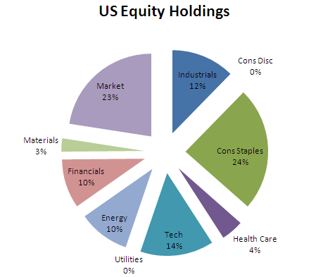
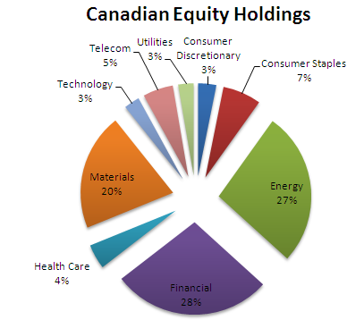
US Equities Strategic Shift

Slide 59
Types of business that are hard to replicate in Canadian Equity portfolio
Altria Group, Inc.
The Coca-Cola Company
Colgate-Palmolive Company
The Procter & Gamble Company
Costco Wholesale Corporation
McDonald's Corporation
Wal-Mart Stores, Inc.
Johnson & Johnson
3M Company
Corning Incorporated
Intel Corporation
Word class brands
Exposure to global
consumer spending
U.S manufacturers’ currency advantage relative to Canada

Slide 60

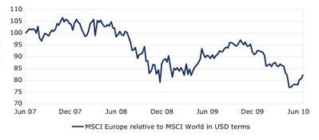
Europe
Europe's Poor Relative Performance Presents Opportunity
Modest reduction in our underweighting EURO

Slide 61
Sold
Company | Value | Trade Price | Reason
CHEVRON CORP | $190,054.27 | 70.47 | Strategy Change
FREEPORT-MCMORAN COPPER & GOLD | $51,729.00 | 64.93 | Strategy Change
GOLDMAN SACHS | $54,809.04 | 137.56 | Strategy Change
VISA INC | $137,971.18 | 76.77 | Strategy Change

Slide 62
Purchased
Company | Value | Trade Price | Current Price | Weights
iSHARES EUROPE 350 | $52,695.00 | 32.80 | 35.13 | 13.58%
SPDR S&P 500 ETF | $179,262.43 | 107.86 | 109.30 | 19.15%
SPDR SECTOR ETF HEALTH | $188,974.35 | 29.04 | 29.09 | 5.90%
SPDR SECTOR ETF TECH | $193,985.00 | 21.53 | 21.67 | 5.96%

Slide 63
Fixed Income
Belinda Liao
bliao@sfu.ca

Slide 64
Review of Strategy
Q4 09
Short Duration in Anticipation of Higher Long-Term Interest Rates
Q1 10
Shifting from Government to Provincial and Moving Duration Closer to Benchmark
Q2 10

Slide 65
Q2 2010 Focus: Duration and Credit
Alpha
High Yield
Duration
Superior Creditworthiness
Source: Bloomberg LP.

Slide 66
Purchased Q2
Bond | Mat | Face Value | YTM
Province of Ontario– C5.35%(AA) | 2 June 2019 | FV $200,000 | 3.86%
Sold Q2
Bond | Mat | Face Value
Province of British Columbia– Strip(AAA) | 18 Jun 2012 | FV $106,614
Bank of Nova Scotia– Strip (AA) | 20 Dec 2012 | FV $70,000

Slide 67
Fixed Income Weight in SIAS Portfolio
9,197,082
Hold Weight
25.6%
24.0%
25.40%
2,407,571
Fixed
Income
Fixed
Income
Fixed
Income
Fixed
Income
2009 Q4
2010 Q1
2010 Q2
Recovery Period

Slide 68
Modified Duration (Years)

Slide 69
Higher Yield, Lower Risk
 | SIAS | DEX
Yield | 3.17% | 3.07%
Duration | 5.75 | 6.06
Convexity | 0.75 | 0.77
Source: Bloomberg LP.

Slide 70
Bond Selection
Alpha
Sector
Tracking Error
Duration
Yield
Credit Analysis

Slide 71
Sector Selection

Slide 72
Sector Allocation
End of Q2
Recovery Period Target
Benchmark
4%
3-5%
Municipal
1.4%
Municipal
17%
15-20%
Government
47.3%
Government
47%
40-45%
Provincial
24.8%
Provincial
32%
35-40%
Corporate
26.5%
Corporate

Slide 73
Bond Selection – Screening Process
DEX Sector
Government
Provincial
Municipal
Corporate
Ranking
/Score
Duration
Weight
Yield
Preliminary Selection
Top 20 bonds in each sector with the highest overall score
Credit Screening
Top 10 bonds with strong credit trustworthiness
Overall Score

Slide 74
Bond Selection – Municipal
Issuer | Rating | Coupon | Maturity Date | Yield | Duration
Montreal | A | 6.00 | Jun 1, 2043 | 5.07 | 15.35
City of Toronto | AA | 5.20 | Jun 1, 2040 | 4.93 | 15.32
Peel Ont Regl Munc | AAA | 5.10 | Jun 29, 2040 | 3.98 | 15.40
B.C. MFA | AAA | 4.95 | Dec 1, 2027 | 3.69 | 11.63
Winnipeg | AA | 5.20 | Jul 17, 2036 | 5.06 | 13.97
Metropolitan Toronto | AA | 6.80 | Jul 26, 2021 | 4.39 | 7.89
Muni Niagara Reg | AA | 5.20 | Jun 30, 2040 | 5.06 | 15.25
City of Toronto | AA | 5.34 | Jul 18, 2027 | 4.63 | 7.21
Winnipeg | AA | 5.90 | Feb 2, 2029 | 4.89 | 11.41
B.C. MFA | AAA | 5.35 | Dec 2, 2024 | 4.50 | 10.15

Slide 75
Bond Selection – Corporate
Issuer | Rating | Coupon | Maturity Date | Yield | Duration
GE Capital Cda Funding | AA | 5.73 | Oct 22, 2037 | 5.65 | 13.64
BNS Capital Trust | A | 5.65 | Dec 31, 2036 | 5.72 | 13.58
Manulife Fin. Delaware LP | A | 5.06 | Dec 15, 2036 | 5.90 | 13.69
Hydro One Inc. | A | 5.36 | May 20, 2036 | 5.16 | 13.99
TD Capital Trust | A | 10.00 | Jun 30, 2039 | 6.12 | 12.42
Hydro One Inc. | A | 4.89 | Mar 13, 2037 | 5.17 | 14.63
SunLife | A | 5.40 | May 29, 2037 | 5.90 | 13.56
Grtr Tor Air Authority | A | 5.63 | Jun 7, 2040 | 5.35 | 14.63
Grtr Tor Air Authority | A | 6.47 | Feb 2, 2034 | 5.33 | 12.11
TransCanada PipeLines | A | 8.05 | Feb 17, 2039 | 5.50 | 13.07

Slide 76
Maturities of Our Current Portfolio
GE Capital Cda Funding
London Ontario
London Ontario
Yield: 3.66%
Province of Ontario

Slide 77
Scenario Analysis
Sell:
Bond | Mat | Face Value | YTM
London Ontario– C5.88%(AAA) | 6 Aug 2017 | FV $50,000 | 3.66%
Purchase:
Scenario 1 - Municipal
Bond | Mat | Face Value | YTM
City of Winnipeg– C5.20%(AA) | 17 Jul 2036 | FV $50,000 | 5.06%
Scenario 2 - Corporate
Bond | Mat | Face Value | YTM
GE Capital Cda Funding– C5.73%(AA) | 22 Oct 2037 | FV $50,000 | 5.65%

Slide 78
Scenario Analysis - Result
 | SIAS |  |  | DEX
 | Status Quo | Scenario 1 | Scenario 2
Yield | 3.17 | 3.20 | 3.21 | 3.07
Duration | 5.75 | 5.93 | 5.92 | 6.06
Convexity | 0.69 | 0.74 | 0.74 | 0.76

Slide 79
Future Strategy
Focus on credit analysis
Reduce tracking error
Higher yield while maintaining duration close to DEX
Q3 2010: no issues maturing

Slide 80
Appendix

Slide 81
Canadian Equity Holdings

Slide 82
Global Equity Holdings (in CADs)

Slide 83
Fixed Income Holdings

Slide 84
